Slide 1
Statewide Violence Prevention Plan
Presentation to ICJIA Board of Directors January 21, 2021

Slide 2
To coordinate statewide violence prevention efforts and assist in the implementation of trauma recovery centers and analyze trauma recovery services. The Authority shall develop, publish, and facilitate the implementation of a 4-year statewide violence prevention plan, which shall incorporate public health, public safety, victim services, and trauma recovery centers and services.
20 ILCS 3930/Section 7(x)

Slide 3
Process
Contracted with University of IL-Urbana Champaign(UIUC) to conduct data analysis and provide technical assistance
Convened state agencies and ICJIA Board member agencies
Provided results from 2018 state agency survey
Secondary Data Analyzed
July 22, 2020
Sept 24, 2020
UIUC completed IRB process to conduct primary data collection
Finalize 4 yr plan
Overview provided at Dec 3, 2020
Submit to LG’s Office for approval
Violence Prevention Plan website and materials available in early 2021
Vision and Guiding Principles drafted and refined
January 22, 2020
May 5 and 27, 2020
June Committee meetings: attendees shared agency programs as well as strengths and challenges
Goal Development
Large Group meetings-October 21 and Nov 19
October Committee meetings: attendees drafted primary, secondary and tertiary goals

Slide 4
Prevention Framework
Violence prevention efforts seek to:
Decrease vulnerability / risk factors
Increase resiliency / protective factors
Importance of Needs Assessments in planning:
What is the prevalence of violence?
What groups are at highest risk?
Where should we target efforts?
What efforts are already happening?

Slide 5
Contributions
Comprehensive Needs Assessment
This is one of the first statewide plans that reviews and consolidates the many different forms of violence.
Compiled / aggregated data sources in one location
Highlighted disparities
Community type & county level reports
Identified risk/protective factors
Collected additional data to address gaps

Slide 6
Data Sources
Type of Violence | Source
Child Maltreatment (Abuse, Neglect) | IL Department of Children & Family Services (Children and Family Research Center) & Children’s Bureau
Youth Violence (Bullying, Dating Violence, Physical Fighting, etc.) & psychosocial indicators | Youth Risk Behavior Surveillance (Centers for Disease Control and Prevention; CDC) Illinois Youth Survey (Center for Prevention Research & Development)
Juvenile Justice Detention for Violent Offenses | Illinois Juvenile Justice Commission & Center for Prevention Research & Development
Adult Violent Crime | Illinois Criminal Justice Information Authority – Criminal History Record Information
Adult Domestic Violence & Sexual Assault | Illinois Criminal Justice Information Authority CDC’s National Intimate Partner and Sexual Violence Survey
Additional | Examples include: Abuse among older adults and persons with disabilities Incarcerated women’s victimization histories Injuries, violent deaths, illegal possession of firearms

Slide 7

Key findings
In Illinois:
About 1 in 4 youth reported experiencing bullying in the past year
About 1 in 5 youth reported engaging in physical fighting in the past year
An estimated 1 in 3 women will experience sexual violence or violent victimization by an intimate partner in their lifetime
Across most forms of violence, Illinois had higher rates of violence compared to the national rates.
Violence | Rate in Illinois | Rate in U.S.
Substantiated Cases of Childhood Maltreatment | 10.95 per 1,000 children | 9.2 per 1,000 children
Adult Violent Offenses (Arrests) | 395.75 violent crimes per 100,000 residents | 368.9 violent crimes per 100,000 residents

Slide 8
Key findings
Disparities – Groups at the highest risk for violence:
Racial, sexual, and gender minorities
LGBTGQIA+ youth (sexual and gender minorities) experience higher rates of youth violence than non-LGBTQIA+ youth
Black youth and adults experienced disproportionately higher rates of juvenile detention and adult arrests/convictions for violent offenses
Within community types and counties
Child maltreatment rate highest in rural counties
Reports of bullying, cyber-bullying, and dating violence highest in rural counties, followed by urban/suburban counties
Physical fighting highest in the city of Chicago

Slide 9
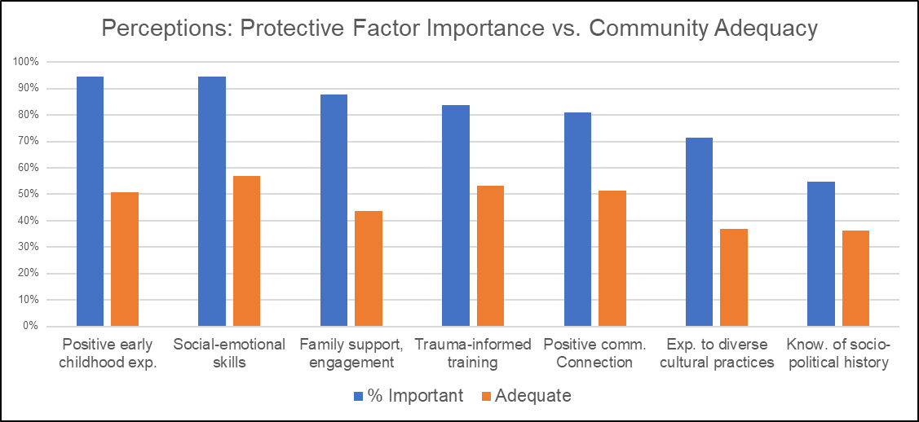
Key findings
Data Collection #1
130 violence prevention and intervention staff across IL
Key findings:
High levels of collaboration with various groups, organizations, agencies
About 33% strongly agreed that violence was a concern to community elected officials
Perceived about 1 in 3 providers across the state to be knowledgeable about evidence-based violence prevention programs

Slide 10
Key findings
Data Collection #2
Representative sample of 712 adult Illinois residents
Key findings:
About 41% of adult residents were aware of organizations or programs in their community that addressed the needs of individuals who experienced violence or trauma
63% of adult residents reported experiencing at least one adverse childhood experience (ACE)
29% had experienced four or more ACEs (higher than national rate*)
Experiencing more ACEs was associated with greater levels of depression, anxiety, and traumatic stress symptoms
Protective factors: Social support, family resilience, and community social cohesion
*National reports suggest that 61% of adults experienced at least one ACE; 17% experienced 4+ ACEs
(CDC; https://www.cdc.gov/violenceprevention/aces/index.html )

Slide 11
Appendices
Violence prevention funding and programs by state agencies
Full needs assessment of violence (secondary and administrative data)
Disparities by race, ethnicity, sex, gender
Additional survey results (Violence prevention and intervention staff; IL adult residents)
ICJIA Violence prevention grantee strategies
Violence data by community type
1. City of Chicago, 2. Suburban Chicago Counties (Suburban Cook, DeKalb, DuPage, Grundy, Kane, Kendall, Lake, McHenry, Will), 3. Other Urban and Suburban Counties (excluding the Suburban Chicago counties listed above; 32 counties), and 4. Rural Counties (61 counties)
Violence data by county (102 Illinois counties)
Needs assessments: Useful for organizations, counties, and agencies → Illustrate the need for programming/policies for specific groups, locations, etc.

Slide 12
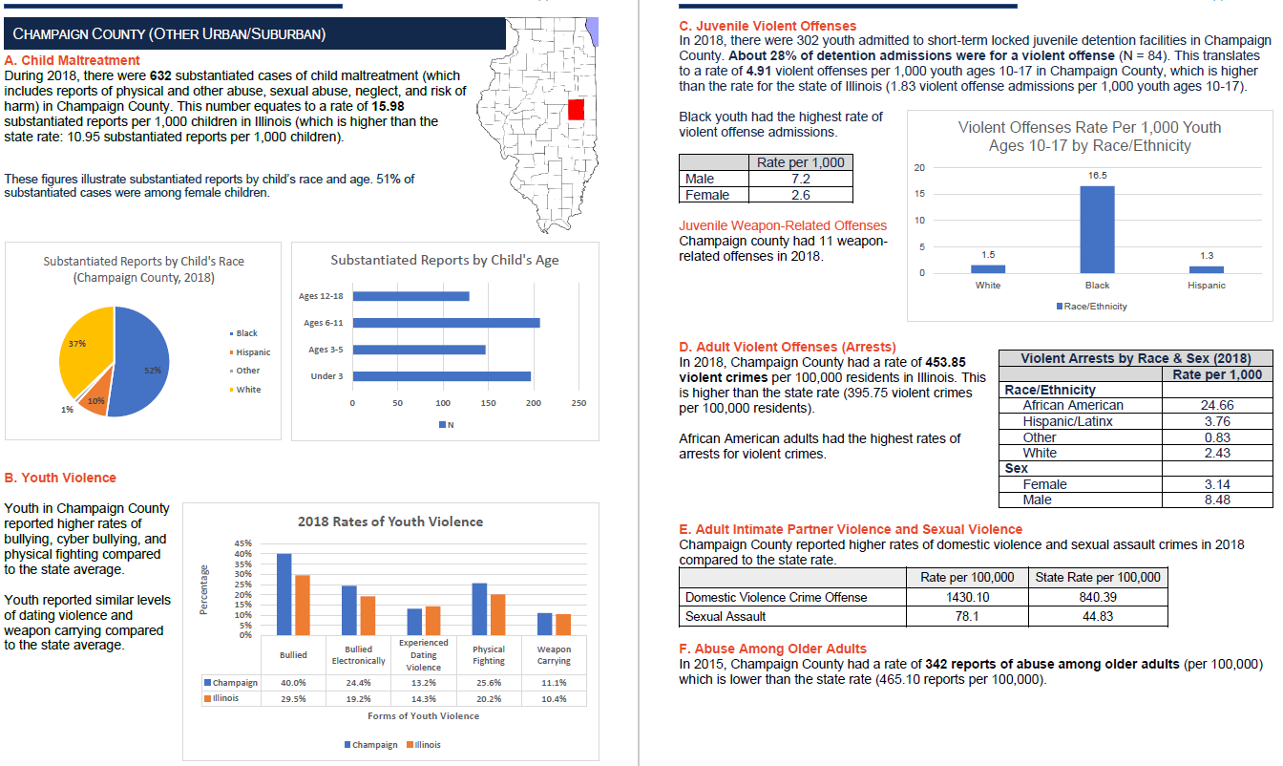
County Appendices - Example

Slide 13
Goals, Objectives and Strategies to design notice of funding opportunities
Balance of best practices and community driven design
Apply needs assessment to program design
Regional difference
High need groups
Higher rates and inequities

Slide 14
Goals, Objectives and Strategies to design notice of funding opportunities
Structure NOFO scoring to advance equity
Further the understanding of the
Importance of relational programming such as mentoring
Interconnections of different forms of violence
Increase of programs that increase protective factors
Multi-generational trauma, multiple victimizations and perpetrations.

Slide 15
2021-Violence Prevention Ad Hoc Committee
Ad Hoc committee of ICJIA Board
Builds on current membership
Ad Hoc allows non Board agencies
Is not duplicative of other state wide coalitions
Quarterly meetings
Presentations on VP grantees, emerging programs, issues
Committees in development
Collaborate across community, municipal and state agencies
NOFO
FY22 NOFO developed 3rd Q of SFY 21
FY22 NOFO Released 4th Q of FY21
4 yr Plan and Implementation in sync with NOFO
ICJIA-Violence Prevention Grant Programs
AG
DJJ
DHS
HFS
DPH
Local government

Slide 16
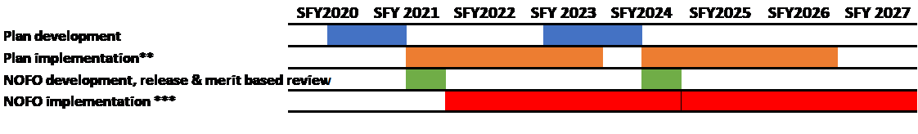
ICJIA Violence Prevention Planning and Implementation Timeline
This chart outlines ICJIA's best intentions to be transparent regarding violence prevention planning and implementation. It must be noted that the timeline outlined below is totally contingent on timely, consistently appropriated State funds. In addition, the actual appropriated language must be general enough to allow for the plan to be applied to the NOFO.
** Plan development + implementation = 4 year plan outlined in statute. *** NOFO implementation includes 2 NOFOs. The black line symbolizes the end of one and the beginning of the next.

